Slide 1
Animal ID – Use and Usability in
CDCB Programs
John B. Cole
National DHIA Annual Meeting, Savannah, FA | March 4, 2026

Slide 2
Animal ID, like Wu-Tang Clan, is forever
The first meeting I attended after joining AIPL in 2003 was on animal ID, and 23 years later we’re still talking about it.
  Technology may be making challenges more severe, not less.
As part of the CDCB Incentives Task Force project we have some recent information on animal ID in the National Cooperator Database.

Slide 3
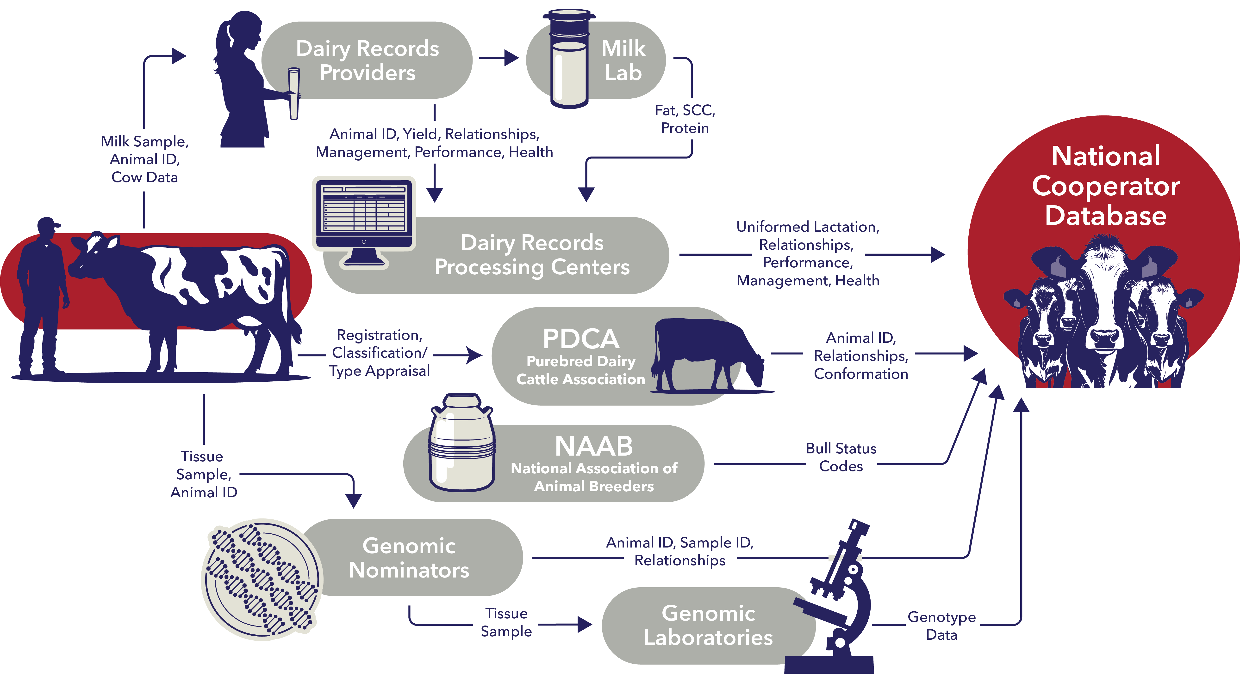

Slide 4
What’s the state of the national herd in 2026?

Slide 5
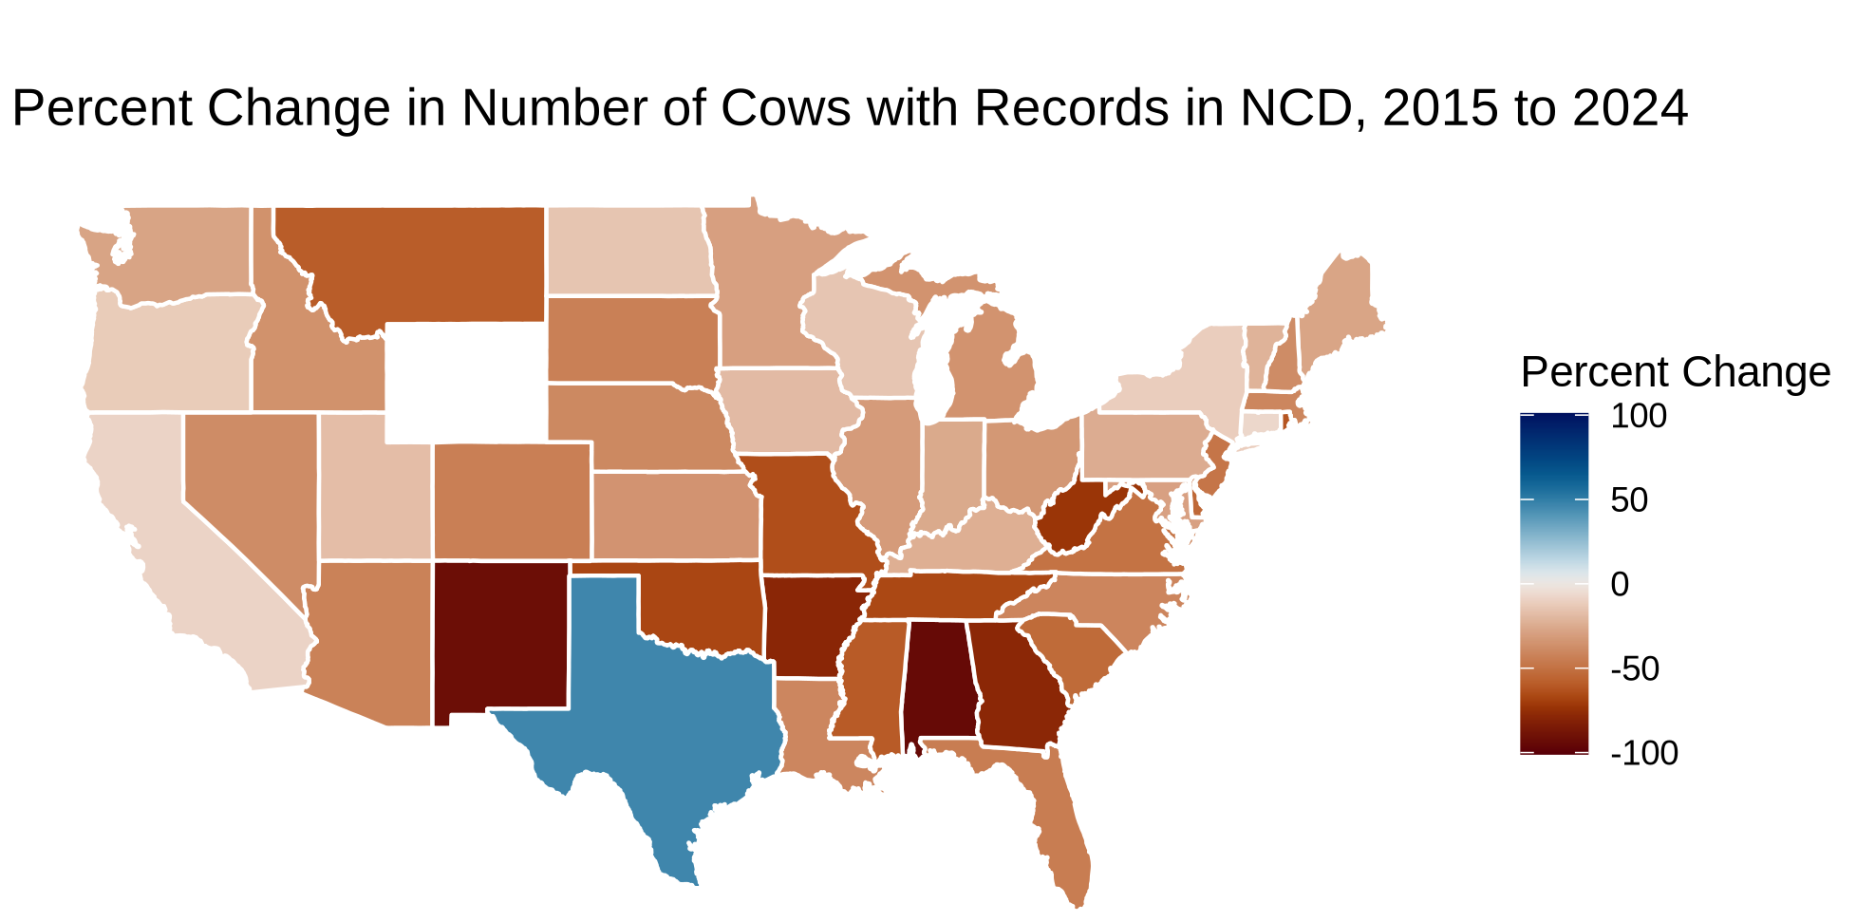

Slide 6
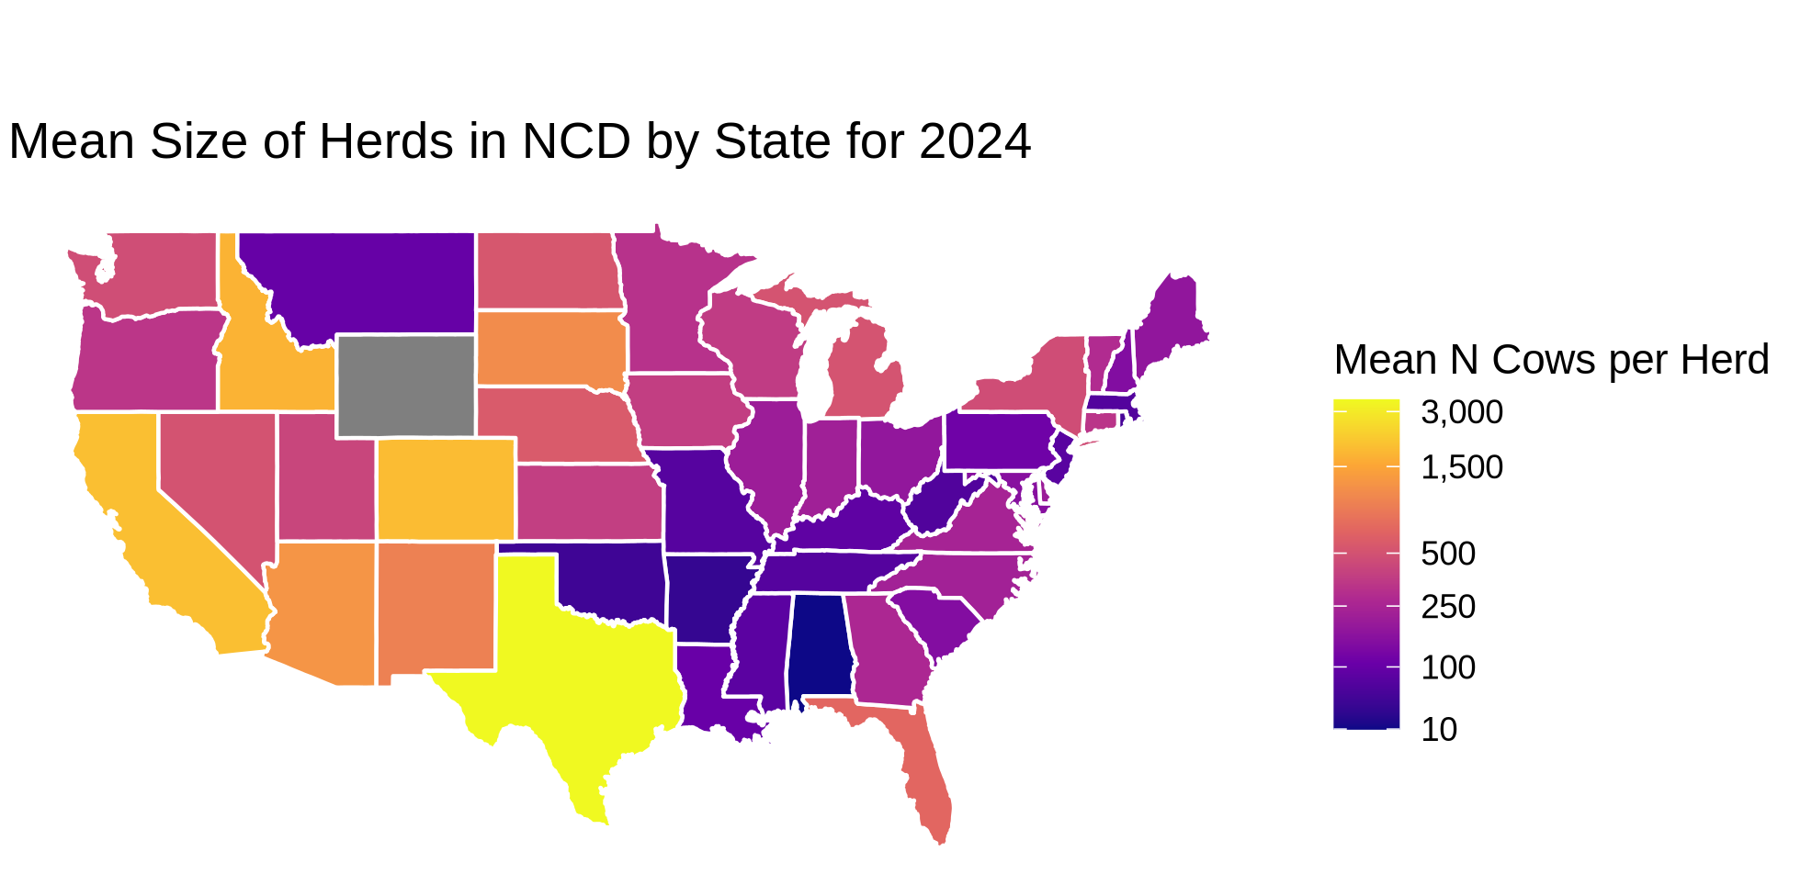

Slide 7
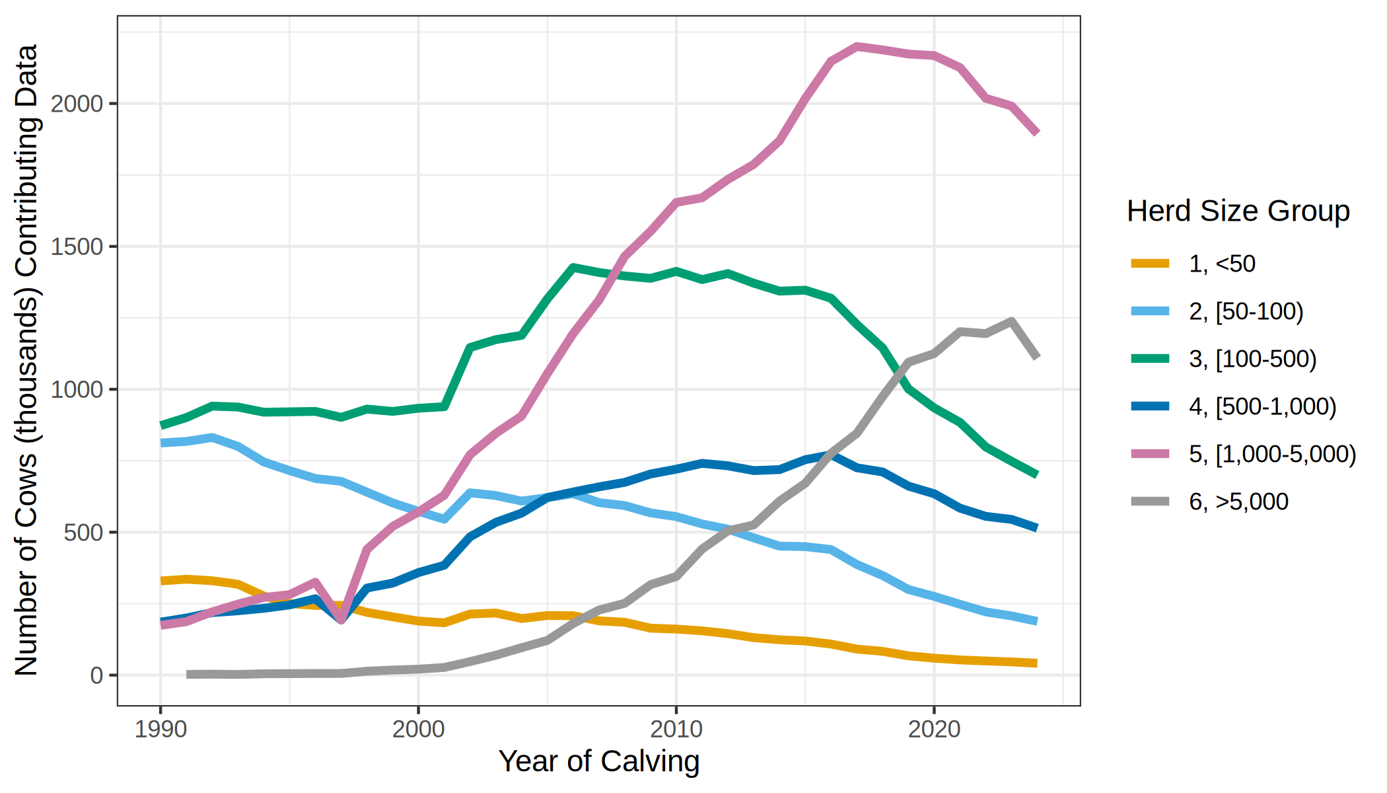
Number of Cows in NCD by Herd Size Group, 1990 to 2024

Slide 8
What are the major reasons records are discarded by EDITS?

Slide 9
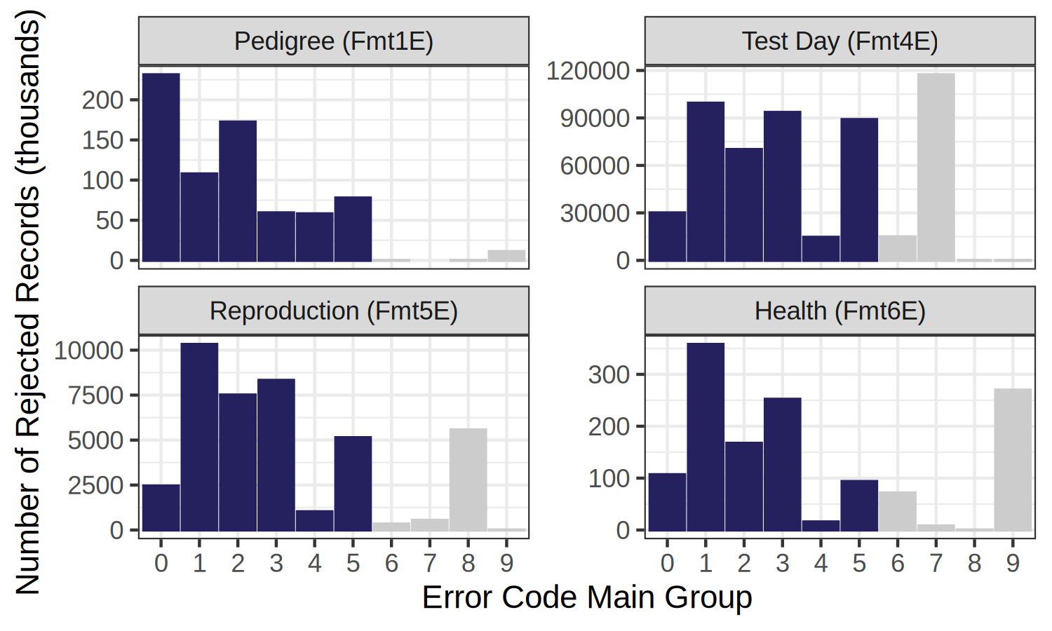
Distribution of error codes by format
0 – General
1 - Animal ID
2 - Sire ID
3 - Dam ID
4 - Cross-Ref ID
5 – Birthdate
6 - Non-TD Production
7 - Test Day
8 – Reproduction
9 - Health

Slide 10
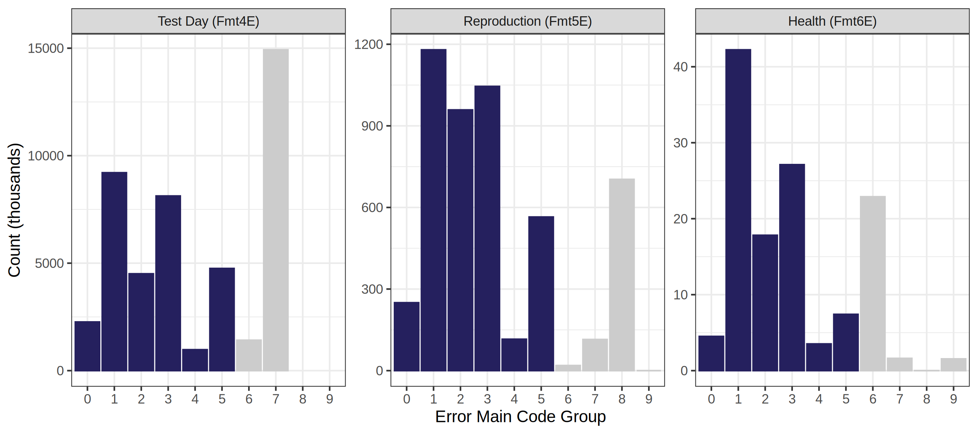
Distribution of error code groups for formats 4E, 5E, and 6E in 2024

Slide 11
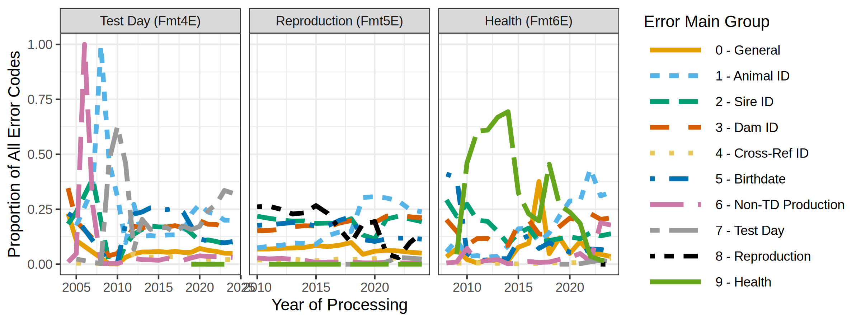
Yearly Trends in Error Codes by Format

Slide 12
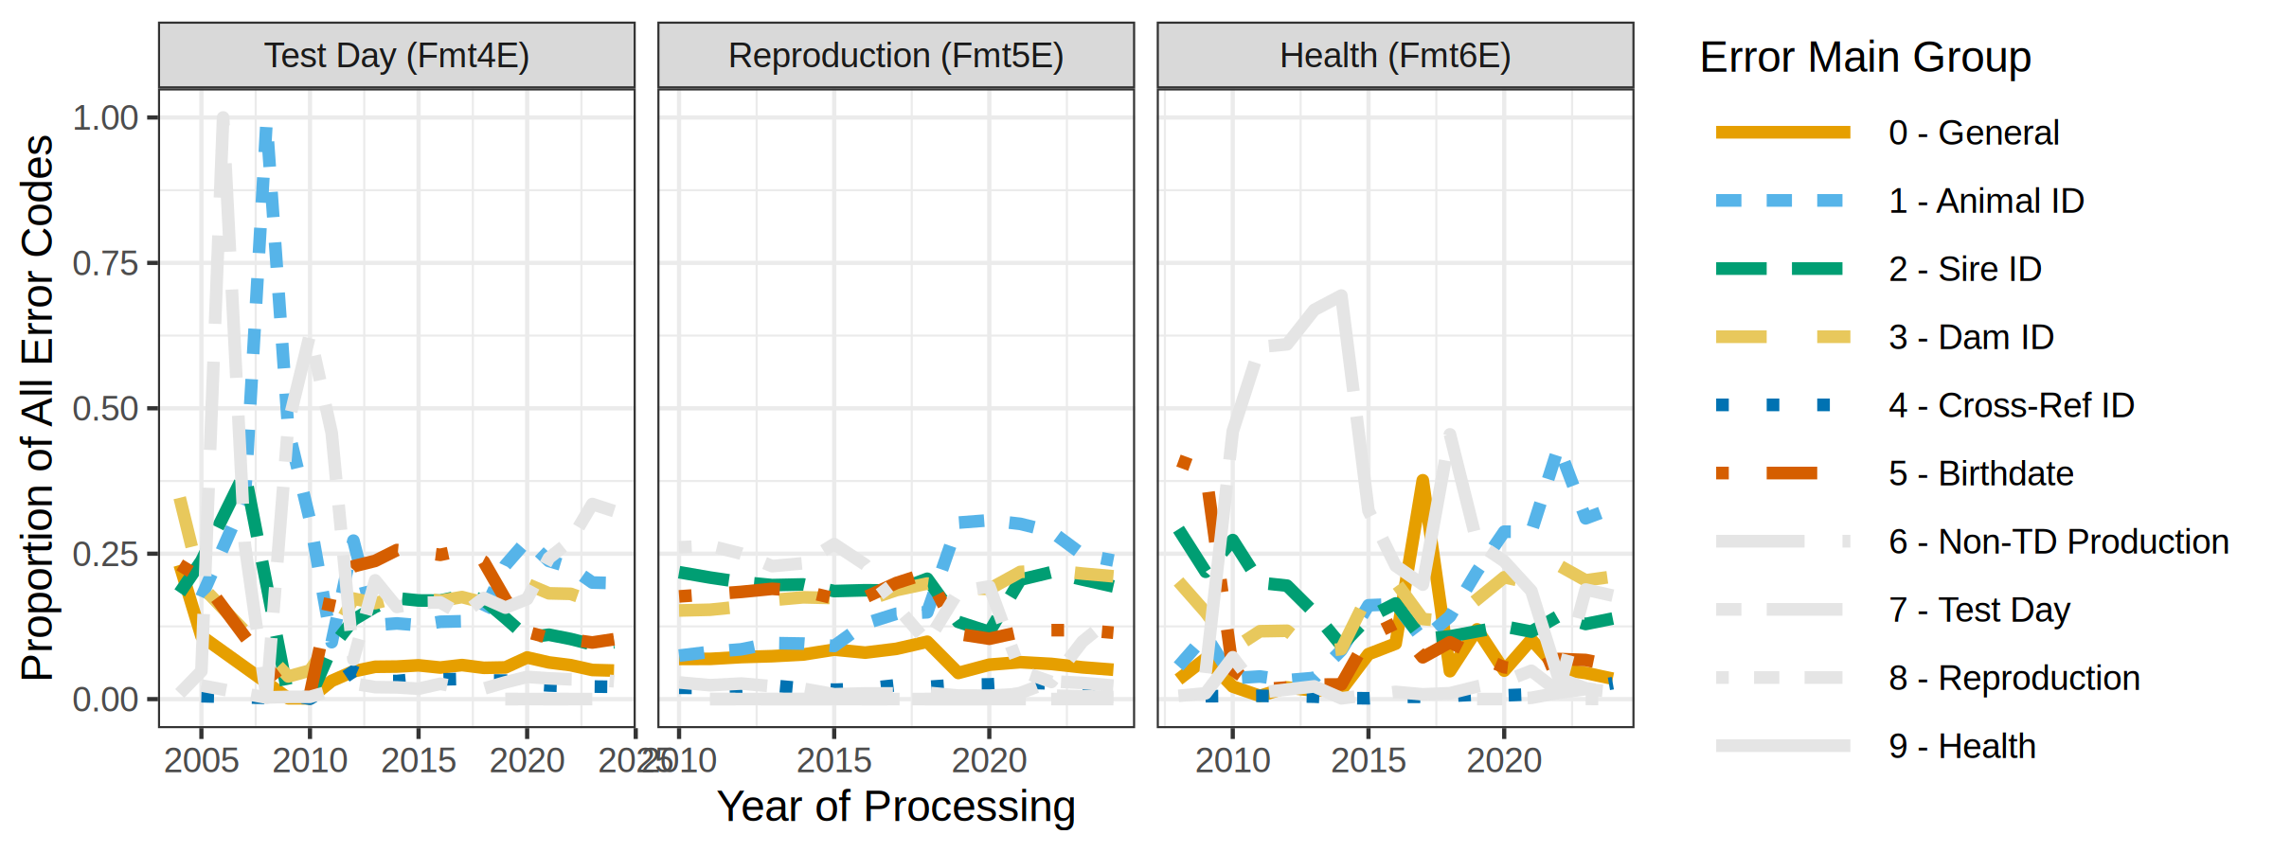
Yearly Trends in Error Codes by Format

Slide 13
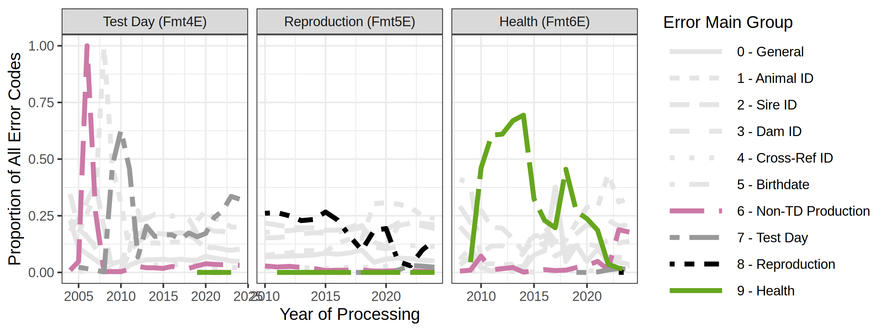
Yearly Trends in Error Codes by Format

Slide 14
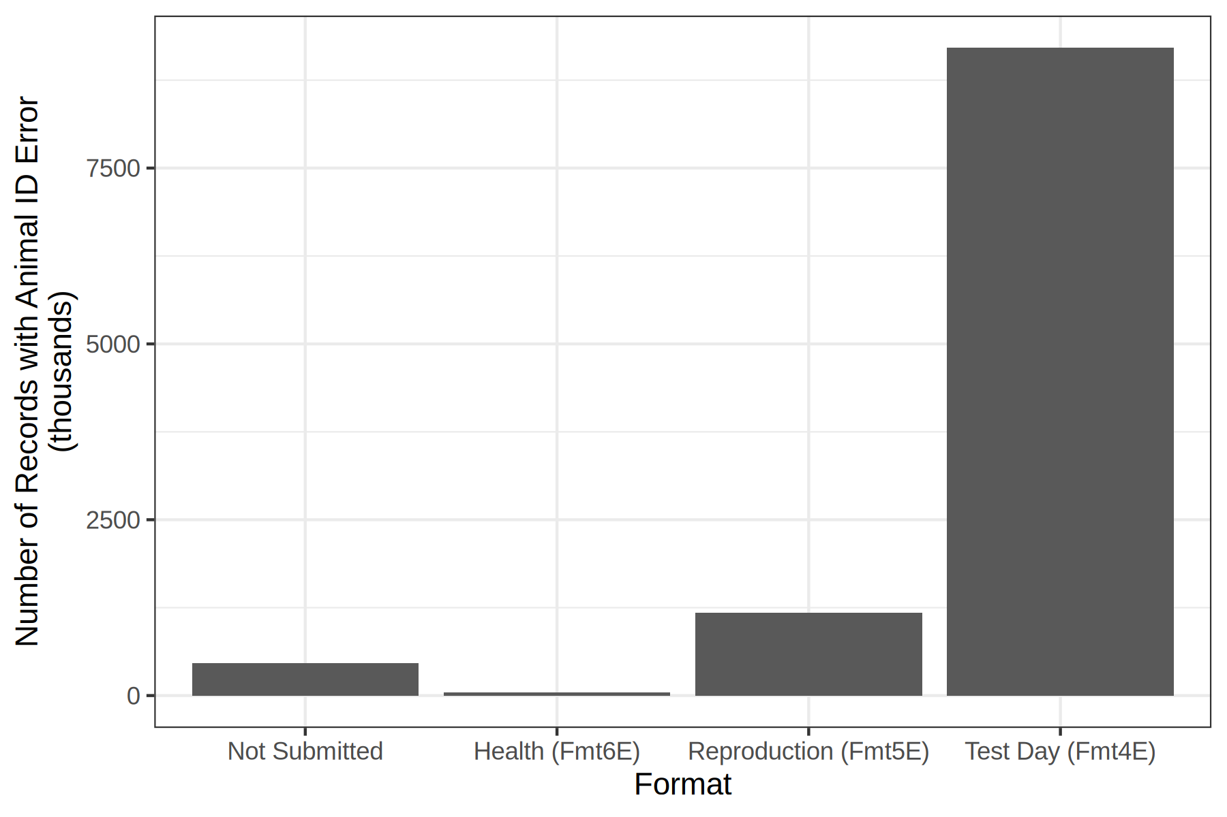
Comparison of the number of live cows with missing ID to number of records with animal ID error in 2024
9.2 mil
Update on ID issues:
DRPCs reported that in their systems they collectively have ~466k live cows with missing IDs in herds that actively contribute data to the NCD – records for these cows are not submitted (guaranteed rejection) so were not accounted for in previously presented error codes.
1.2 mil
466k
42k

Slide 15
Conclusions
Dr. Ashley Ling at CDCB did the hard work of assembling these data.
Poor-quality animal ID is the main reason pedigree, lactation, reproduction, and health events fail edits.
Hundreds of thousands of records aren’t transmitted from DRPCs to the NCD because ID is incomplete.
The problem isn’t just tags, it’s software.

Slide 16
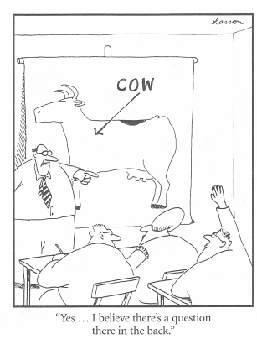
Questions?
Thank you for your
interest!
john.cole@uscdcb.com

